Slide 1

Jingga
Business solutions made simple.
Subtitle goes here

Slide 2

Table of Contents
Introduction
Topic 1
Topic 2
Topic 3
Topic 4
Topic 5
Next steps
Q&A

Slide 3

What is Jingga?
Jingga is a collection of tools & workflows to map your business processes and support you in your everyday business operations.

Slide 4

Sample List
Multiple platforms and OS
PC / Mac / Linux
Desktop / Laptop / Tablet / Smartphone
Hosted in the cloud or your local servers
End-user benefits
Simple & intuitive
Saves time
Automates and streamlines processes
Company benefits
Improves quality and reduces risks
Improves productivity
Modular
Fair pricing (with price guarantee)
Security
Audit logs
Data encryption
Blockchain data integrity
Application integrity validation

Slide 5
Sample List
[Text]
[Text]
[Text]
[Text]
[Text]
Sample text

Slide 6

Sample Chart
Project Management
CMS
Office Tools
Finance
CRM
Shop
Production
ERP
Analysis
QM

Slide 7
Sample Options
Title 1
Some description for this box goes here
Title 2
Some description for this box goes here
Title 3
Some description for this box goes here
Title 4
Some description for this box goes here
Title 5
Some description for this box goes here
Title 6
Some description for this box goes here

Slide 8
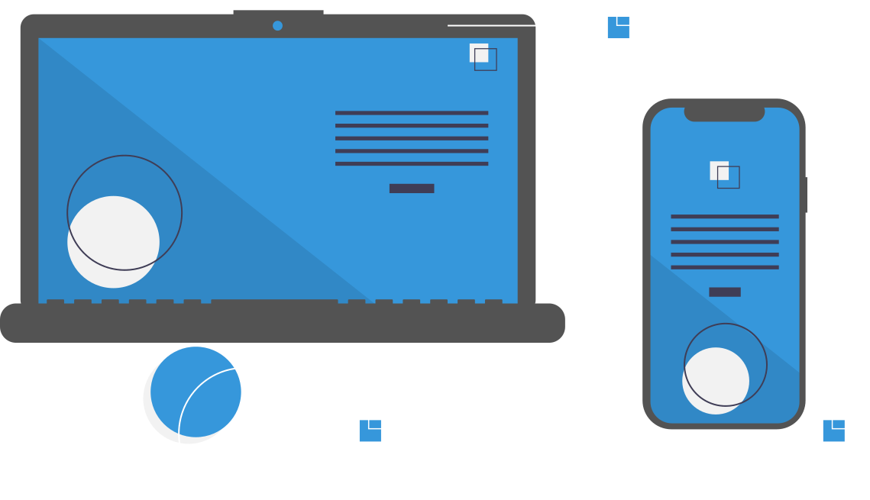
Placeholder

Slide 9
Option 1
Option 2
Description here
Description here

Slide 10
Sample Options
Tier 1 - No Discount
0.0 %
Per month, per user
[1 - 10 users]
Price guarantee for 12 months.
Tier 2 - Discount
-2.5 %
Per month, per user
[11 - 50 users]
Price guarantee for 18 months.
Tier 3 - Discount
-5.0 %
Per month, per user
[51 - 250 users]
Price guarantee for 24 months.
Tier 4 - Discount
-7.5 %
Per month, per user
[251 - 500 users]
Price guarantee for 36 months.
Tier 5 - Discount
-10.0 %
Per month, per user
[501 - 1000 users]
Price guarantee for 48 months.
Tier 6 - Discount
TBD
Per month, per user
[1001 - ??? users]
Price guarantee TBD.
* discounts and guarantees depend on maintaining the respective license quantities. For details regarding the discounts check the general terms and conditions
Notes:
Depending on the amount of modules and licenses it sometimes can make sense to order one or two additional licenses without needing them in order to get into the next tier level.

Slide 11
Sample Options
Basic
€ 9.99
Medium
€ 14.99
Advanced
€ 19.99
Custom
TBD
Per month, per user
Per month, per user
Per month, per user
Per month, per user
The base price depends on the module selection. Price guarantee for 12 months.
The base price depends on the module selection. Price guarantee for 18 months.
The base price depends on the module selection. Price guarantee for 24 months.
Conditions and features to be discussed individually.
Key components:
Customer Management
Supplier Management
Item Management
Billing
Accounting
Additional key components:
Asset Management
Warehouse Management
Contract Management
Jobs
Workflows
Additional key components:
Cash
Financial reporting
Tax reporting
Helper
Checklist
Additional key components:
To be discussed
* all prices without hosting, support, maintenance, etc. excl. VAT
* the customers can add additional modules to these predefined packages based on their need
* prices for individual / additional modules depend on the module (please check out the shop)

Slide 12
Next Steps
Step 1
Step 2
Step 3
Step 4
Step 5
Step 6
More details describing this step
More details describing this step
More details describing this step
More details describing this step
More details describing this step
More details describing this step

Slide 13
Thank you very much!
Q&A
jingga.app
info@jingga.app
+49 123 / 4567890

Slide 14
Jingga
Business solutions made simple.
https://jingga.app

